Slide 1
Better regulation to support patients and professionals
Stefan Czerniawski, Executive Director, Strategy
Gordon Matheson CBE, Head of Scottish Affairs
Friday 19 April 2024

Slide 2
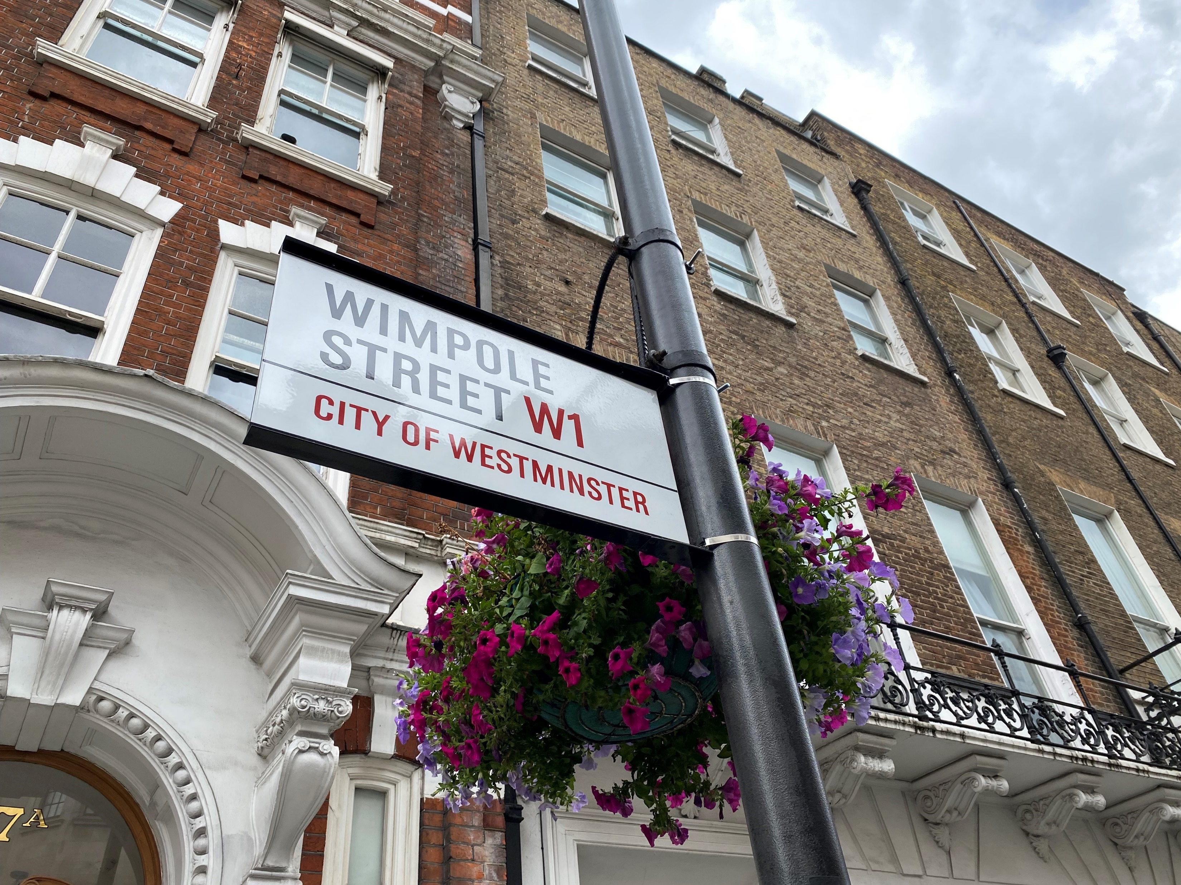
GDC in Scotland 4-nation regulator across devolved UK LDC Scotland, Stirling
Local contact/‘face’
Link to wider GDC
Promote current GDC priorities
Engage professions/sector
Student/VT/Fellows presentations

Slide 3
Process improvement
Professionalism
Provisional registration
Working patterns

Slide 4
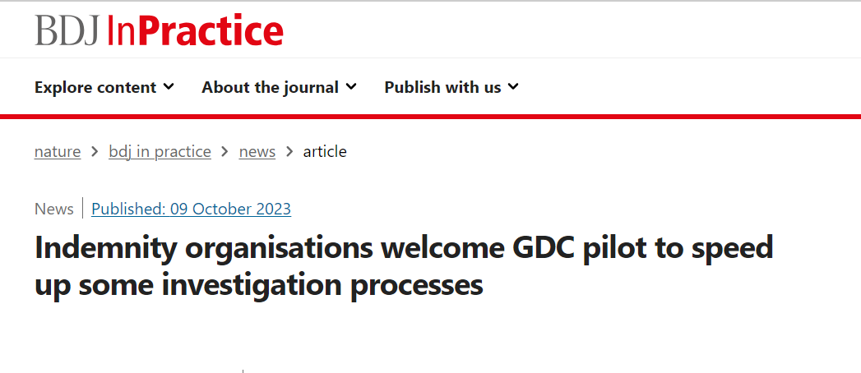
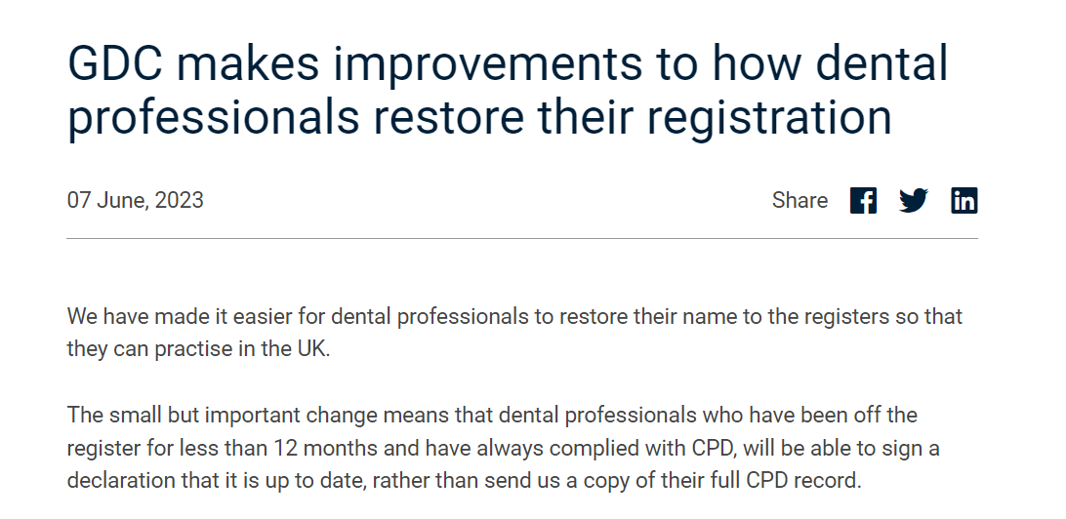

Slide 5
Scope of Practice
Indemnity
Reporting

Slide 6
Principles of professionalism
1: Treat patients with respect
Treat your patients with dignity and support them to make informed decisions about their care.
2: Practise safely and effectively
Ensure you use your knowledge and skills to provide the right outcome for your patients, keep up to date, and speak up to protect others.
3: Maintain trust in the profession
Act with integrity and ensure your actions maintain the trust of colleagues, patients, and the public.
4: Work in partnership with others
Work with colleagues to ensure an effective and supportive environment in which the safety and wellbeing of the patient and dental team is protected.

Slide 8
New working patterns data
60% of dentists
Spend all or most of their time providing NHS care
16% of dentists
Spend all or most of their time providing private care
Scotland
42% of dentists
Spend all or most of their time providing NHS care
32% of dentists
Spend all or most of their time providing private care
UK

Slide 9
Useful links
Registration – new rules for international registration; Specialist List Assessed Applications
Provisional registration – DHSC consultation and GDC’s welcome
FtP – transparency, trust and improving processes; initial enquiries pilot; and improvement to processes
Dental workforce patterns data
Professionalism – standards and guidance
Notes:
~

Slide 10
Thank you!
sczerniawski@gdc-uk.org
gmatheson@gdc-uk.org
Notes:
.

